Slide 1


EMOTION DETECTION
Team No: 286
BY: G.Gayatri, Ch.Tejasri, P.Harini, P.Monika Sai

Slide 2
BASICALLY HUMANS CARRY LOT OF EMOTIONS
INTRODUCTION:
Emotions like: Surprise, Sad , Angry , Happy,Neutral etc…

Slide 3
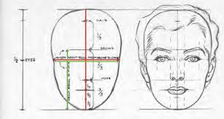
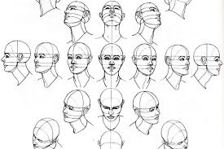
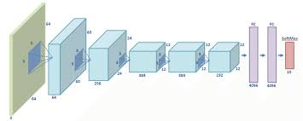
EMOTION DETECTION :
FACE
DETECTION
FACE EXTRACTION
CLASSIFICATION
MODEL
EMOTION
RECOGNISATION SYSTEM

Slide 4
LIBRARIES USED:
Keras
Numpy
OpenCV

Slide 5

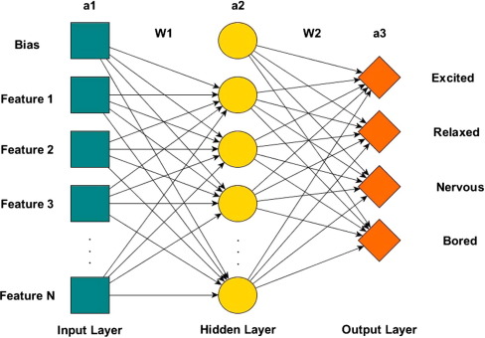
FRAMEWORKS
SEQUENTIAL CNN

Slide 6
CNN MODEL:
Convolutional Neural Networks are a type of Deep Learning Algorithm that take the image as input and learns the various feature of the image through filters.
This allow them to learn the important objects present in the image, allowing them to discern one image from the object.

Slide 7

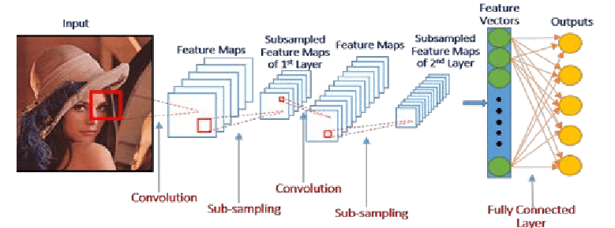

Slide 8
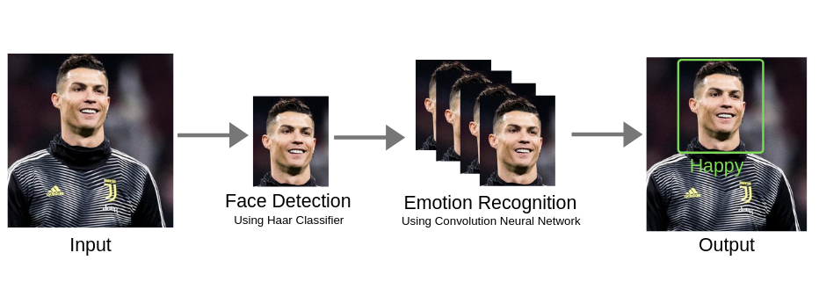

SAMPLE OUTPUT :
----Input----
surprise
---Output---

Slide 9
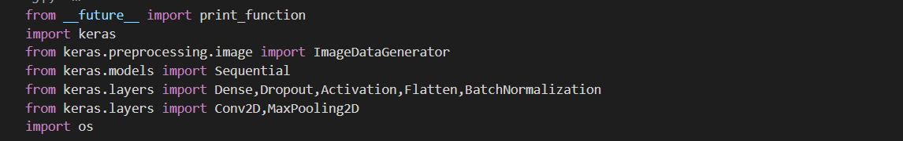
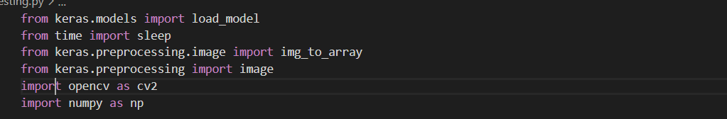
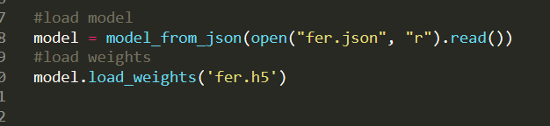

---->used for model and weights---->used for model and weights
PACKAGES USED :
---->used for model and weights
---->used for Video Capture

Slide 10
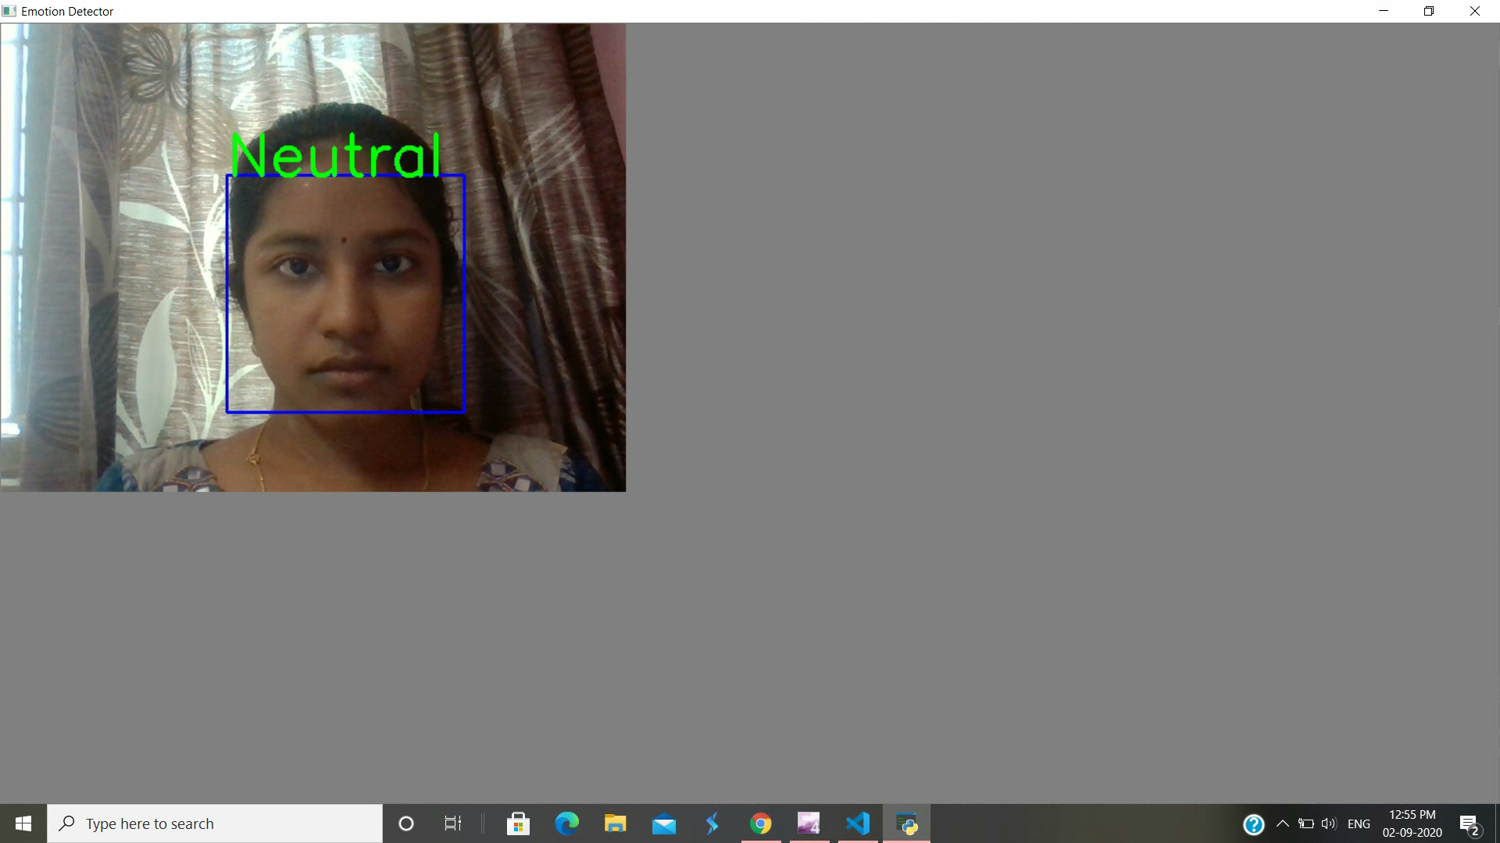

Slide 11
Project link : https://github.com/monikasai197/facialexp

Slide 12


